Slide 1
Image Filtering

Slide 2
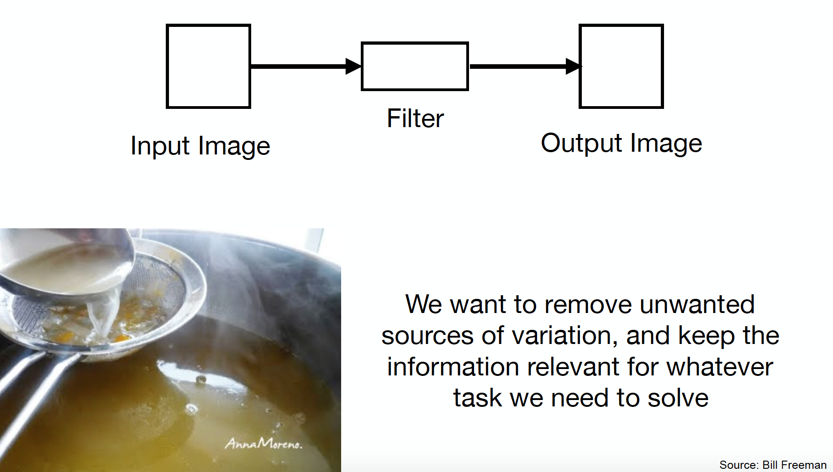
Image Filtering

Slide 3
Image filtering
Image filtering: for each pixel, compute function of local neighborhood and output a new value
Function specified by a “filter” or mask saying how to combine values from neighbors.
Same function applied at each position
Output and input image are typically the same size
Adapted from Derek Hoiem

Slide 4
Image filtering
Linear filtering: function is a weighted sum/difference of pixel values
Uses of filtering:
Enhance images
Denoise, smooth, increase contrast, etc.
Extract information from images
Texture, edges, distinctive points, etc.
Detect patterns
Template matching
Convolutional Neural Networks
Adapted from Derek Hoiem

Slide 5
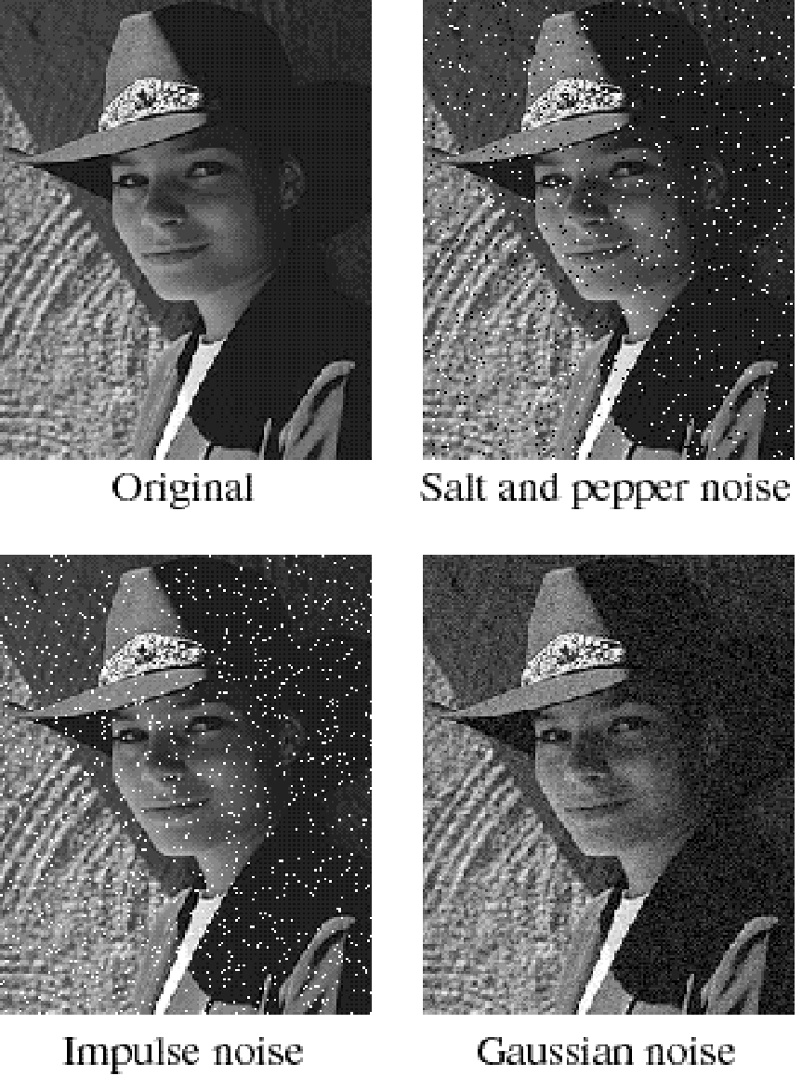
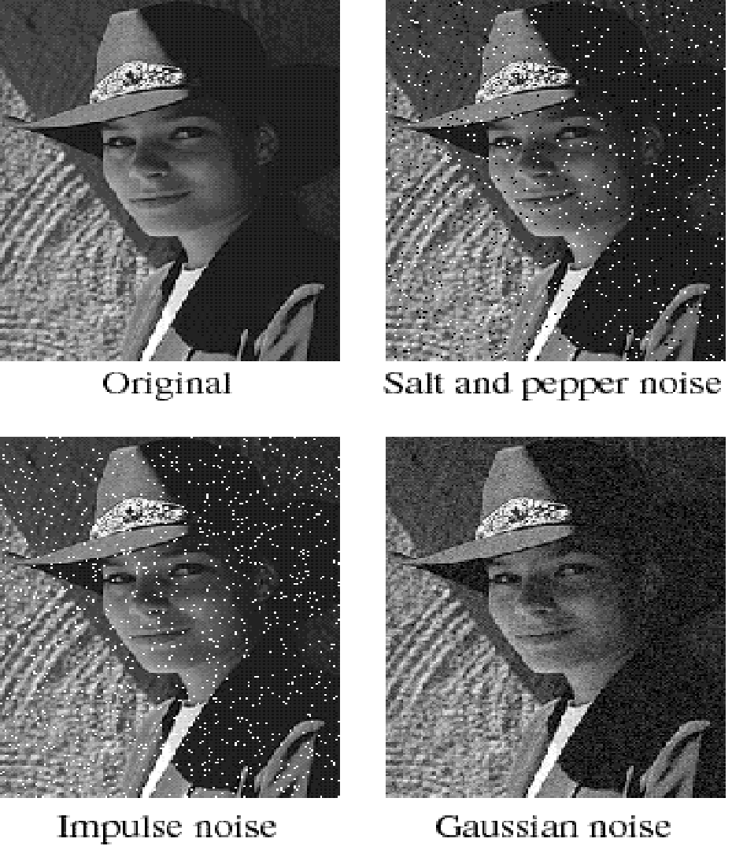
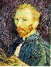
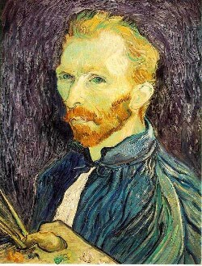
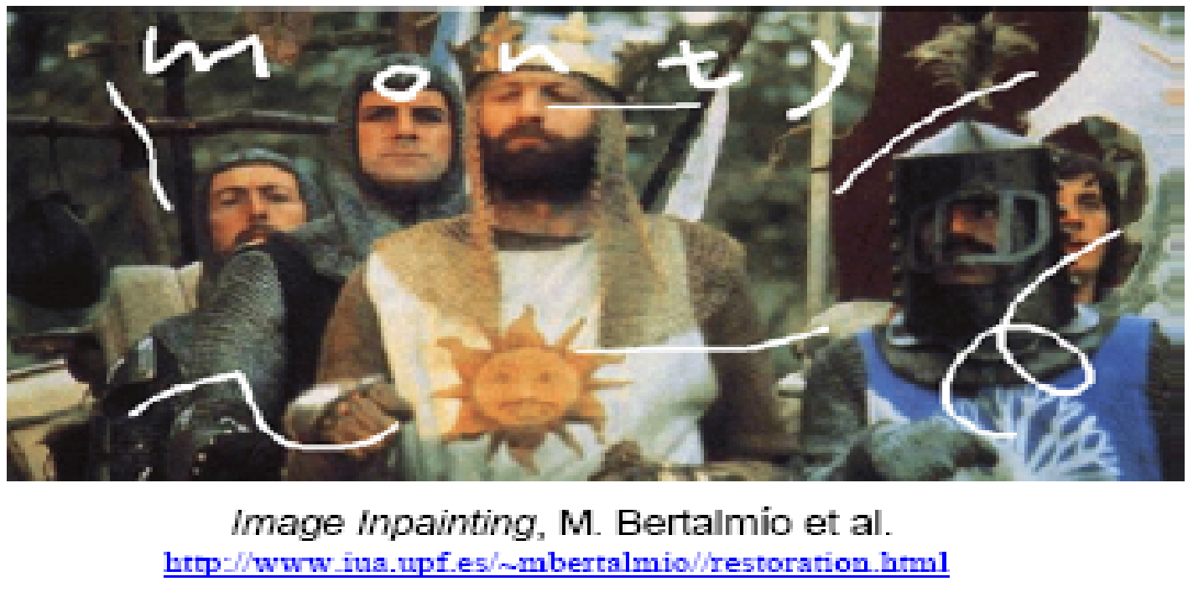
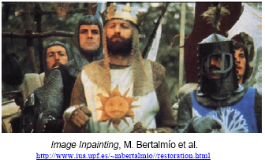
Super-resolution
De-noising
In-painting
Bertamio et al

Slide 6
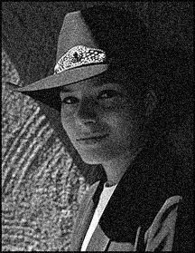
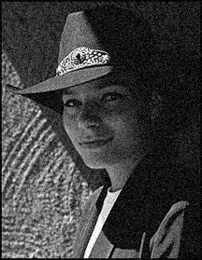

Noise reduction
Given a camera and a still scene, how can you reduce noise?
Take lots of images and average them!
What’s the next best thing?
Source: S. Seitz
Notes:
Answer: take lots of images, average them

Slide 7
First attempt at a solution
Let’s replace each pixel with an average of all the values in its neighborhood
Assumptions:
Expect pixels to be like their neighbors
Expect noise processes to be independent from pixel to pixel

Slide 8
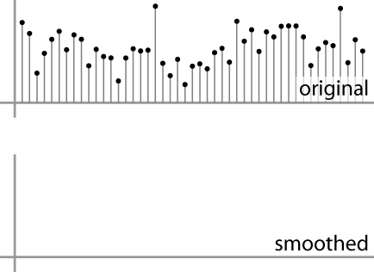
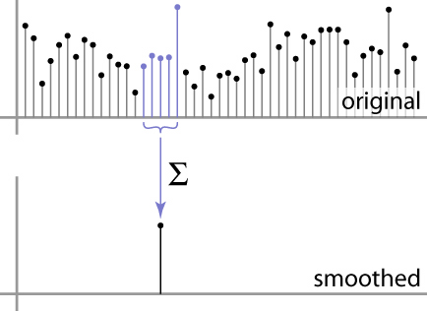
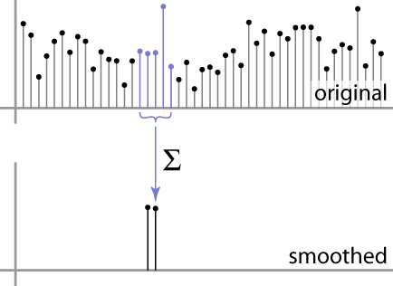
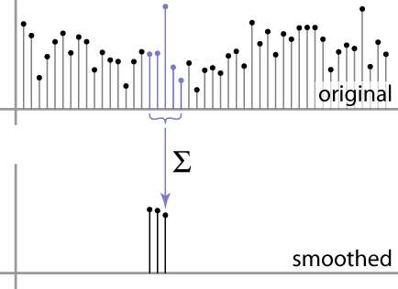
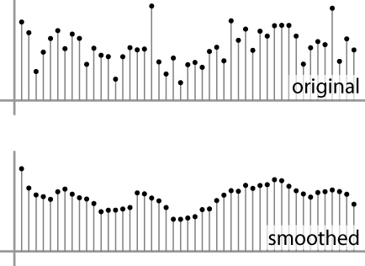
First attempt at a solution
Let’s replace each pixel with an average of all the values in its neighborhood
Moving average in 1D:
Source: S. Marschner

Slide 9
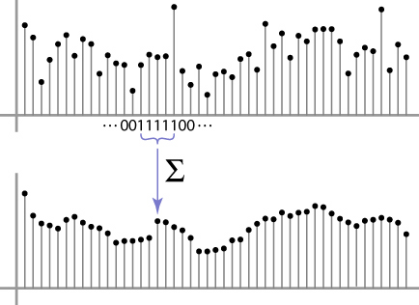
Weighted Moving Average
Can add weights to our moving average
Weights [1, 1, 1, 1, 1] / 5
Source: S. Marschner

Slide 10

Weighted Moving Average
Non-uniform weights [1, 4, 6, 4, 1] / 16
Source: S. Marschner

Slide 11
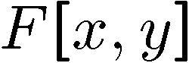
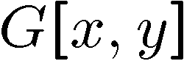
Moving Average In 2D
0 | 0 | 0 | 0 | 0 | 0 | 0 | 0 | 0 | 0
0 | 0 | 0 | 0 | 0 | 0 | 0 | 0 | 0 | 0
0 | 0 | 0 | 90 | 90 | 90 | 90 | 90 | 0 | 0
0 | 0 | 0 | 90 | 90 | 90 | 90 | 90 | 0 | 0
0 | 0 | 0 | 90 | 90 | 90 | 90 | 90 | 0 | 0
0 | 0 | 0 | 90 | 0 | 90 | 90 | 90 | 0 | 0
0 | 0 | 0 | 90 | 90 | 90 | 90 | 90 | 0 | 0
0 | 0 | 0 | 0 | 0 | 0 | 0 | 0 | 0 | 0
0 | 0 | 90 | 0 | 0 | 0 | 0 | 0 | 0 | 0
0 | 0 | 0 | 0 | 0 | 0 | 0 | 0 | 0 | 0
 | 0
0 | 0 | 0 | 0 | 0 | 0 | 0 | 0 | 0 | 0
0 | 0 | 0 | 0 | 0 | 0 | 0 | 0 | 0 | 0
0 | 0 | 0 | 90 | 90 | 90 | 90 | 90 | 0 | 0
0 | 0 | 0 | 90 | 90 | 90 | 90 | 90 | 0 | 0
0 | 0 | 0 | 90 | 90 | 90 | 90 | 90 | 0 | 0
0 | 0 | 0 | 90 | 0 | 90 | 90 | 90 | 0 | 0
0 | 0 | 0 | 90 | 90 | 90 | 90 | 90 | 0 | 0
0 | 0 | 0 | 0 | 0 | 0 | 0 | 0 | 0 | 0
0 | 0 | 90 | 0 | 0 | 0 | 0 | 0 | 0 | 0
0 | 0 | 0 | 0 | 0 | 0 | 0 | 0 | 0 | 0
Source: S. Seitz
Notes:
ones, divide by 9

Slide 12
Moving Average In 2D
0 | 0 | 0 | 0 | 0 | 0 | 0 | 0 | 0 | 0
0 | 0 | 0 | 0 | 0 | 0 | 0 | 0 | 0 | 0
0 | 0 | 0 | 90 | 90 | 90 | 90 | 90 | 0 | 0
0 | 0 | 0 | 90 | 90 | 90 | 90 | 90 | 0 | 0
0 | 0 | 0 | 90 | 90 | 90 | 90 | 90 | 0 | 0
0 | 0 | 0 | 90 | 0 | 90 | 90 | 90 | 0 | 0
0 | 0 | 0 | 90 | 90 | 90 | 90 | 90 | 0 | 0
0 | 0 | 0 | 0 | 0 | 0 | 0 | 0 | 0 | 0
0 | 0 | 90 | 0 | 0 | 0 | 0 | 0 | 0 | 0
0 | 0 | 0 | 0 | 0 | 0 | 0 | 0 | 0 | 0
 | 0 | 10
0 | 0 | 0 | 0 | 0 | 0 | 0 | 0 | 0 | 0
0 | 0 | 0 | 0 | 0 | 0 | 0 | 0 | 0 | 0
0 | 0 | 0 | 90 | 90 | 90 | 90 | 90 | 0 | 0
0 | 0 | 0 | 90 | 90 | 90 | 90 | 90 | 0 | 0
0 | 0 | 0 | 90 | 90 | 90 | 90 | 90 | 0 | 0
0 | 0 | 0 | 90 | 0 | 90 | 90 | 90 | 0 | 0
0 | 0 | 0 | 90 | 90 | 90 | 90 | 90 | 0 | 0
0 | 0 | 0 | 0 | 0 | 0 | 0 | 0 | 0 | 0
0 | 0 | 90 | 0 | 0 | 0 | 0 | 0 | 0 | 0
0 | 0 | 0 | 0 | 0 | 0 | 0 | 0 | 0 | 0
Source: S. Seitz
Notes:
ones, divide by 9

Slide 13
Moving Average In 2D
0 | 0 | 0 | 0 | 0 | 0 | 0 | 0 | 0 | 0
0 | 0 | 0 | 0 | 0 | 0 | 0 | 0 | 0 | 0
0 | 0 | 0 | 90 | 90 | 90 | 90 | 90 | 0 | 0
0 | 0 | 0 | 90 | 90 | 90 | 90 | 90 | 0 | 0
0 | 0 | 0 | 90 | 90 | 90 | 90 | 90 | 0 | 0
0 | 0 | 0 | 90 | 0 | 90 | 90 | 90 | 0 | 0
0 | 0 | 0 | 90 | 90 | 90 | 90 | 90 | 0 | 0
0 | 0 | 0 | 0 | 0 | 0 | 0 | 0 | 0 | 0
0 | 0 | 90 | 0 | 0 | 0 | 0 | 0 | 0 | 0
0 | 0 | 0 | 0 | 0 | 0 | 0 | 0 | 0 | 0
 | 0 | 10 | 20
0 | 0 | 0 | 0 | 0 | 0 | 0 | 0 | 0 | 0
0 | 0 | 0 | 0 | 0 | 0 | 0 | 0 | 0 | 0
0 | 0 | 0 | 90 | 90 | 90 | 90 | 90 | 0 | 0
0 | 0 | 0 | 90 | 90 | 90 | 90 | 90 | 0 | 0
0 | 0 | 0 | 90 | 90 | 90 | 90 | 90 | 0 | 0
0 | 0 | 0 | 90 | 0 | 90 | 90 | 90 | 0 | 0
0 | 0 | 0 | 90 | 90 | 90 | 90 | 90 | 0 | 0
0 | 0 | 0 | 0 | 0 | 0 | 0 | 0 | 0 | 0
0 | 0 | 90 | 0 | 0 | 0 | 0 | 0 | 0 | 0
0 | 0 | 0 | 0 | 0 | 0 | 0 | 0 | 0 | 0
Source: S. Seitz
Notes:
ones, divide by 9

Slide 14
Moving Average In 2D
0 | 0 | 0 | 0 | 0 | 0 | 0 | 0 | 0 | 0
0 | 0 | 0 | 0 | 0 | 0 | 0 | 0 | 0 | 0
0 | 0 | 0 | 90 | 90 | 90 | 90 | 90 | 0 | 0
0 | 0 | 0 | 90 | 90 | 90 | 90 | 90 | 0 | 0
0 | 0 | 0 | 90 | 90 | 90 | 90 | 90 | 0 | 0
0 | 0 | 0 | 90 | 0 | 90 | 90 | 90 | 0 | 0
0 | 0 | 0 | 90 | 90 | 90 | 90 | 90 | 0 | 0
0 | 0 | 0 | 0 | 0 | 0 | 0 | 0 | 0 | 0
0 | 0 | 90 | 0 | 0 | 0 | 0 | 0 | 0 | 0
0 | 0 | 0 | 0 | 0 | 0 | 0 | 0 | 0 | 0
 | 0 | 10 | 20 | 30
0 | 0 | 0 | 0 | 0 | 0 | 0 | 0 | 0 | 0
0 | 0 | 0 | 0 | 0 | 0 | 0 | 0 | 0 | 0
0 | 0 | 0 | 90 | 90 | 90 | 90 | 90 | 0 | 0
0 | 0 | 0 | 90 | 90 | 90 | 90 | 90 | 0 | 0
0 | 0 | 0 | 90 | 90 | 90 | 90 | 90 | 0 | 0
0 | 0 | 0 | 90 | 0 | 90 | 90 | 90 | 0 | 0
0 | 0 | 0 | 90 | 90 | 90 | 90 | 90 | 0 | 0
0 | 0 | 0 | 0 | 0 | 0 | 0 | 0 | 0 | 0
0 | 0 | 90 | 0 | 0 | 0 | 0 | 0 | 0 | 0
0 | 0 | 0 | 0 | 0 | 0 | 0 | 0 | 0 | 0
Source: S. Seitz
Notes:
ones, divide by 9

Slide 15
Moving Average In 2D
0 | 0 | 0 | 0 | 0 | 0 | 0 | 0 | 0 | 0
0 | 0 | 0 | 0 | 0 | 0 | 0 | 0 | 0 | 0
0 | 0 | 0 | 90 | 90 | 90 | 90 | 90 | 0 | 0
0 | 0 | 0 | 90 | 90 | 90 | 90 | 90 | 0 | 0
0 | 0 | 0 | 90 | 90 | 90 | 90 | 90 | 0 | 0
0 | 0 | 0 | 90 | 0 | 90 | 90 | 90 | 0 | 0
0 | 0 | 0 | 90 | 90 | 90 | 90 | 90 | 0 | 0
0 | 0 | 0 | 0 | 0 | 0 | 0 | 0 | 0 | 0
0 | 0 | 90 | 0 | 0 | 0 | 0 | 0 | 0 | 0
0 | 0 | 0 | 0 | 0 | 0 | 0 | 0 | 0 | 0
 | 0 | 10 | 20 | 30 | 30
Source: S. Seitz
Notes:
ones, divide by 9

Slide 16
Moving Average In 2D
0 | 0 | 0 | 0 | 0 | 0 | 0 | 0 | 0 | 0
0 | 0 | 0 | 0 | 0 | 0 | 0 | 0 | 0 | 0
0 | 0 | 0 | 90 | 90 | 90 | 90 | 90 | 0 | 0
0 | 0 | 0 | 90 | 90 | 90 | 90 | 90 | 0 | 0
0 | 0 | 0 | 90 | 90 | 90 | 90 | 90 | 0 | 0
0 | 0 | 0 | 90 | 0 | 90 | 90 | 90 | 0 | 0
0 | 0 | 0 | 90 | 90 | 90 | 90 | 90 | 0 | 0
0 | 0 | 0 | 0 | 0 | 0 | 0 | 0 | 0 | 0
0 | 0 | 90 | 0 | 0 | 0 | 0 | 0 | 0 | 0
0 | 0 | 0 | 0 | 0 | 0 | 0 | 0 | 0 | 0
 | 0 | 10 | 20 | 30 | 30 | 30 | 20 | 10
 | 0 | 20 | 40 | 60 | 60 | 60 | 40 | 20
 | 0 | 30 | 60 | 90 | 90 | 90 | 60 | 30
 | 0 | 30 | 50 | 80 | 80 | 90 | 60 | 30
 | 0 | 30 | 50 | 80 | 80 | 90 | 60 | 30
 | 0 | 20 | 30 | 50 | 50 | 60 | 40 | 20
 | 10 | 20 | 30 | 30 | 30 | 30 | 20 | 10
 | 10 | 10 | 10 | 0 | 0 | 0 | 0 | 0
Source: S. Seitz
Notes:
ones, divide by 9

Slide 17
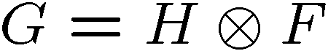
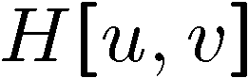

Averaging filter
What values belong in the kernel H for the moving average example?
0 | 0 | 0 | 0 | 0 | 0 | 0 | 0 | 0 | 0
0 | 0 | 0 | 0 | 0 | 0 | 0 | 0 | 0 | 0
0 | 0 | 0 | 90 | 90 | 90 | 90 | 90 | 0 | 0
0 | 0 | 0 | 90 | 90 | 90 | 90 | 90 | 0 | 0
0 | 0 | 0 | 90 | 90 | 90 | 90 | 90 | 0 | 0
0 | 0 | 0 | 90 | 0 | 90 | 90 | 90 | 0 | 0
0 | 0 | 0 | 90 | 90 | 90 | 90 | 90 | 0 | 0
0 | 0 | 0 | 0 | 0 | 0 | 0 | 0 | 0 | 0
0 | 0 | 90 | 0 | 0 | 0 | 0 | 0 | 0 | 0
0 | 0 | 0 | 0 | 0 | 0 | 0 | 0 | 0 | 0
 | 0 | 10 | 20 | 30 | 30
1
1
1
1
?
1
1
1
1
1
“box filter”

Slide 18
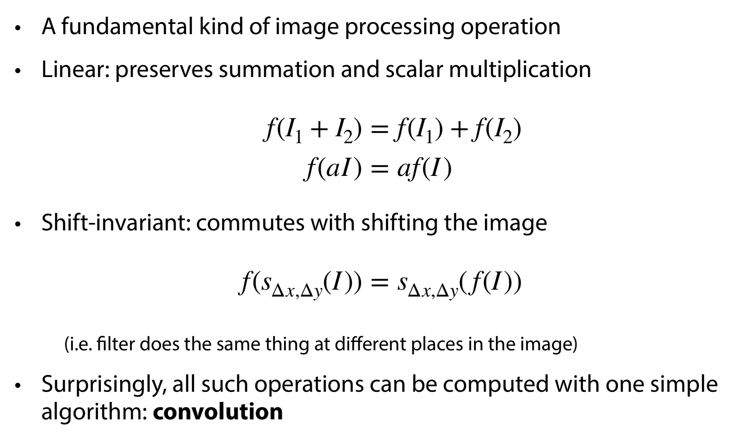
Linear, shift-invariant filters
Slide by S. Marschner

Slide 19
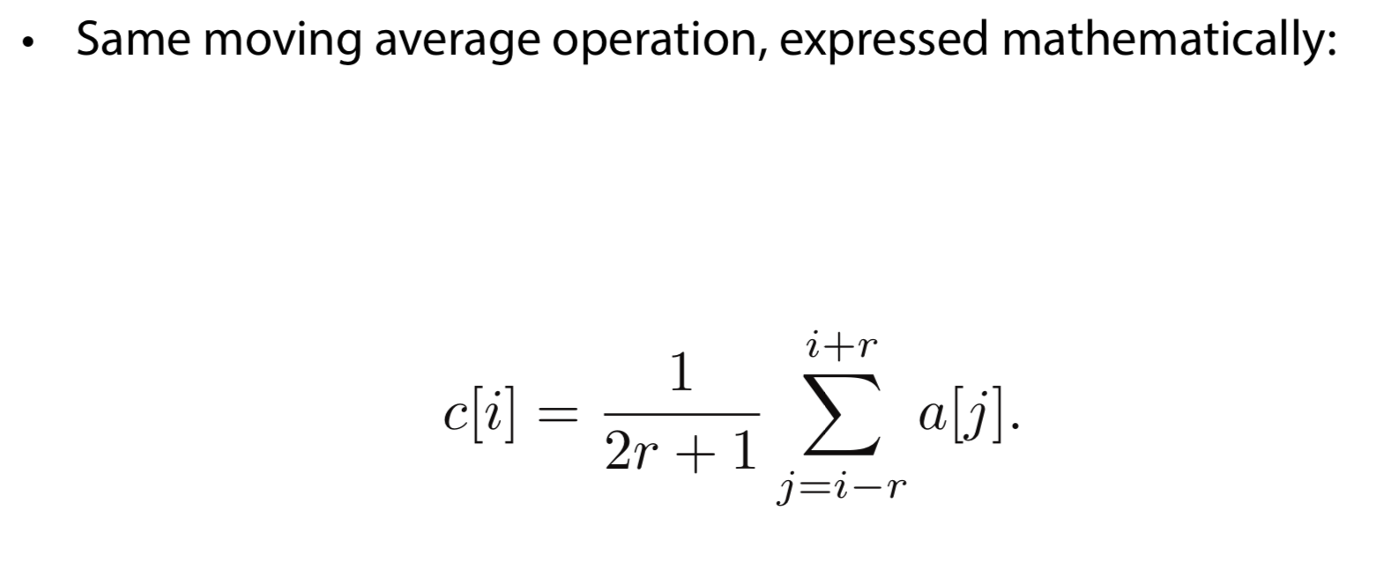
Convolution
Slide by S. Marschner

Slide 20
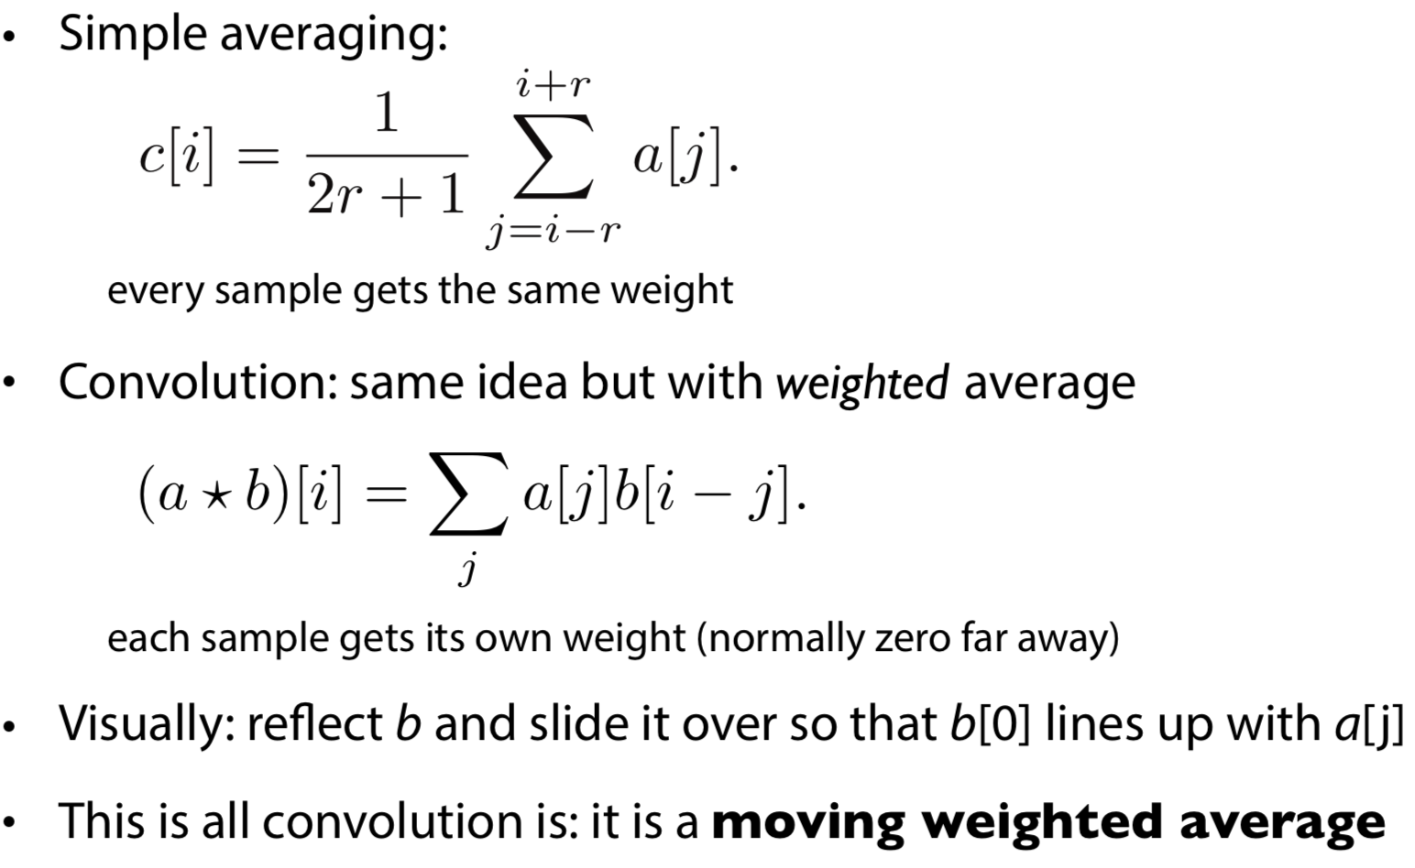
Convolution
Slide by S. Marschner

Slide 21
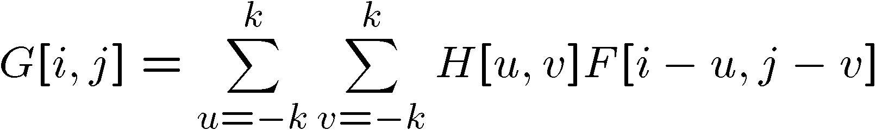

Convolution
Convolution:
Flip the filter in both dimensions (bottom to top, right to left)
1
2
(0,0)
1
H
2
H
3
4
3
4
F
Notation for convolution operator
(N,N)
Slide credit: Kristen Grauman

Slide 22
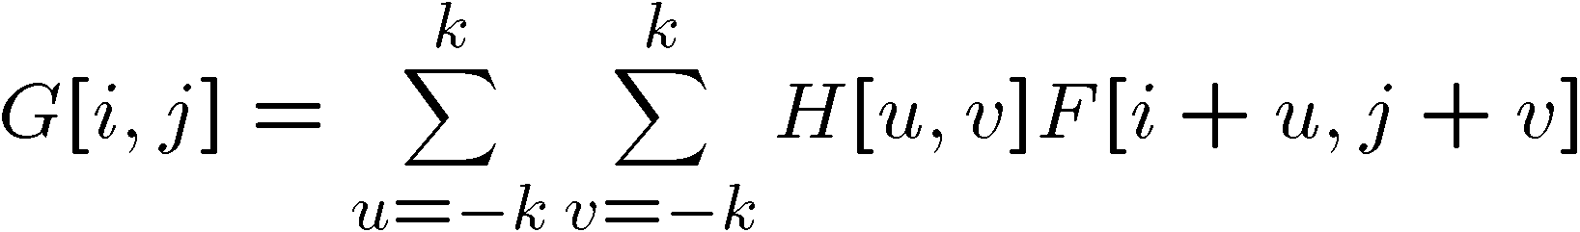
Correlation filtering
This is called cross-correlation, denoted
Filtering an image: replace each pixel with a linear combination of its neighbors.
Conceptually simpler, but not as nice as convolution
1
2
(0,0)
H
3
4
F
(N,N)

Slide 23
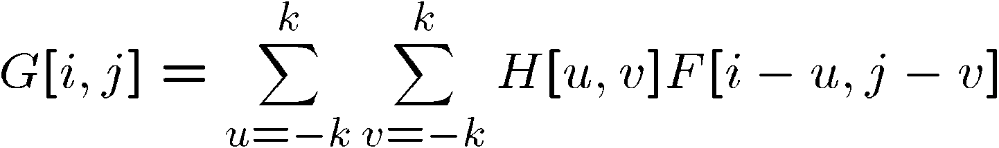
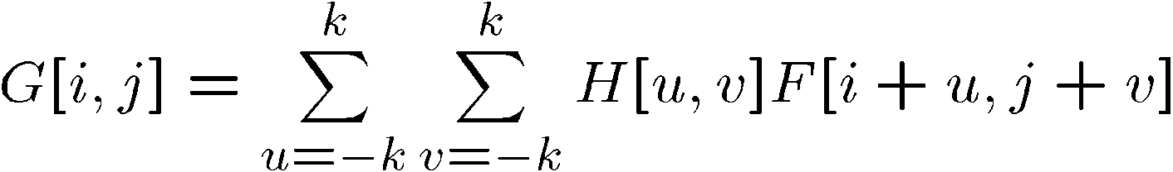
Convolution vs. correlation
Convolution
Cross-correlation
For a Gaussian or box filter, how will the outputs differ?
If the input is an impulse signal, how will the outputs differ?

Slide 24
Correlation vs. Convolution
Correlation
Convolution
Note
If H[-u,-v] = H[u,v] (if the filter is symmetric) then correlation ≡ convolution.
Matlab: filter2 imfilter
Note the difference!
Matlab: conv2
Slide credit: Kristen Grauman

Slide 25
Properties of Convolution
Linear and shift-invariant
Commutative: a * b = b * a
Associative: a * (b * c) = (a * b) * c
Often apply several filters one after another: (((a * b₁) * b₂) * b₃)
This is equivalent to applying one filter: a * (b₁ * b₂ * b₃)
Distributes over addition: a * (b + c) = (a * b) + (a * c)
Scalars factor out: ka * b = a * kb = k (a * b)
Identity: unit impulse e = [0, 0, 1, 0, 0], a * e = a
Source: S. Lazebnik
Notes:
25

Slide 26
Example for Correlation filtering calculation
0 | 1 | 2
1 | 3 | 2
8 | 4 | 0
Original Filter
IMAGE
FILTER
10 | 10 | 20
0 | 5 | 3
0 | 7 | 2
0 | 1 | 2
1 | 3 | 2
8 | 4 | 0
99
*
=
(0*10) + (1*10) + (2*20) + (1*0) + (3*5) + (2*3) + (8*0) + (4*7) + (0*2)

Slide 27
Example for Convolution filtering calculation
0 | 1 | 2
1 | 3 | 2
8 | 4 | 0
Original Filter
10 | 10 | 20
0 | 5 | 3
0 | 7 | 2
0 | 4 | 8
2 | 3 | 1
2 | 1 | 0
225
*
=
(0*10) + (4*10) + (8*20) + (2*0) + (3*5) + (1*3) + (2*0) + (1*7) + (0*2)

Slide 28
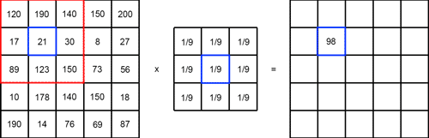
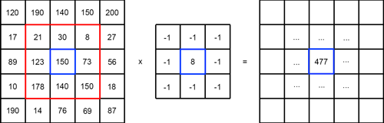

Slide 29
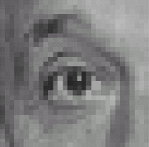
Practice with linear filters
0
0
0
?
0
1
0
0
0
0
Original
Source: D. Lowe
Notes:
29

Slide 30
Practice with linear filters
0
0
0
0
1
0
0
0
0
Original
Filtered
(no change)
Notes:
30

Slide 31
Practice with linear filters
0
0
0
?
0
0
1
0
0
0
Original
Source: D. Lowe
Notes:
31

Slide 32
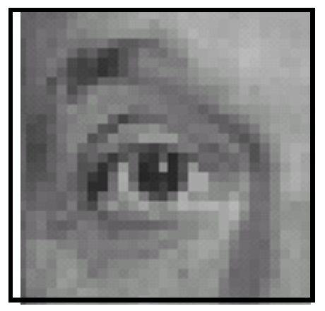
Practice with linear filters
0
0
0
0
0
1
0
0
0
Original
Shifted right
by 1 pixel with convolution
Source: D. Lowe
Notes:
32
This is if we assume filter already flipped – will shift right if we flip the fitler first for convolution

Slide 33
Practice with linear filters
0
0
0
0
0
1
0
0
0
Original
Shifted left
by 1 pixel with correlation
Source: D. Lowe
Notes:
33
This is if we assume filter already flipped – will shift right if we flip the fitler first for convolution

Slide 34
Practice with linear filters
1
1
1
?
1
1
1
1
1
1
Original
Source: D. Lowe
Notes:
34

Slide 35
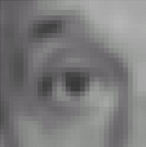
Practice with linear filters
1
1
1
1
1
1
1
1
1
Original
Blur (with a
box filter)
Source: D. Lowe
Notes:
35

Slide 36

Practice with linear filters
0
0
0
-
1
1
1
?
0
2
0
1
1
1
0
0
0
1
1
1
Original
Source: D. Lowe
Notes:
36

Slide 37
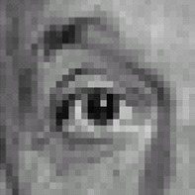
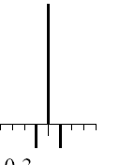
Practice with linear filters
0
0
0
-
1
1
1
0
2
0
1
1
1
0
0
0
1
1
1
Original
Sharpening filter
Accentuates differences with local average
Source: D. Lowe
Notes:
37

Slide 38
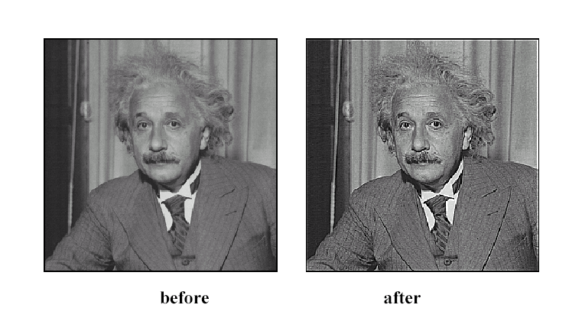
Sharpening
Source: D. Lowe
Notes:
38

Slide 39
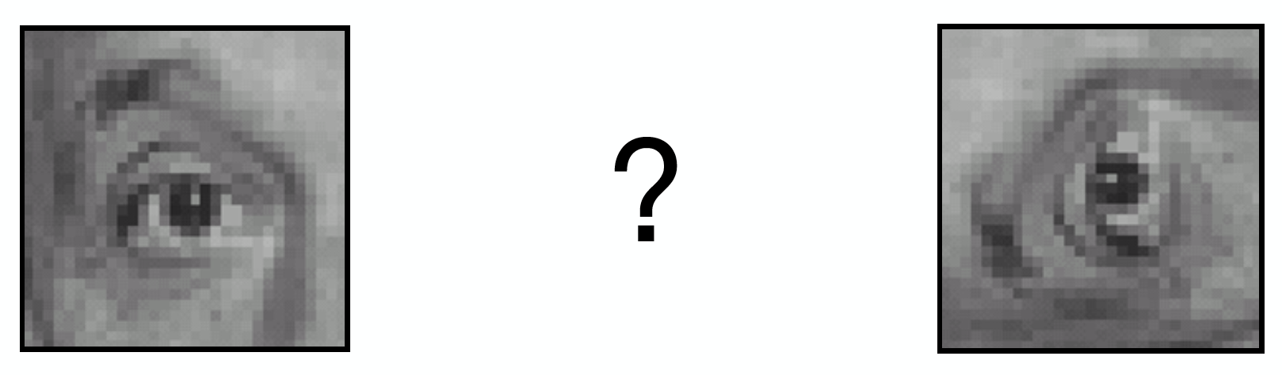
Practice with linear filters
Interactive tool for some filters: https://setosa.io/ev/image-kernels/

Slide 40
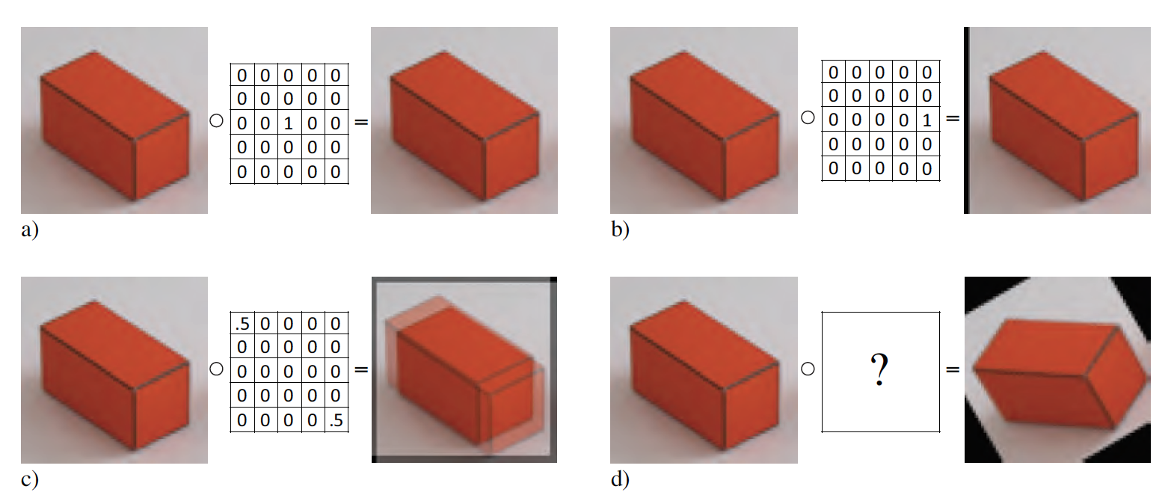
Practice with linear filters

Slide 41
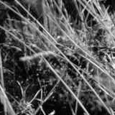
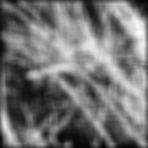
Smoothing with box filter revisited
What’s wrong with this picture?
What’s the solution?
Source: D. Forsyth
Notes:
41

Slide 42
Smoothing with box filter revisited
What’s wrong with this picture?
What’s the solution?
To eliminate edge effects, weight contribution of neighborhood pixels according to their closeness to the center
“fuzzy blob”
Notes:
42

Slide 43
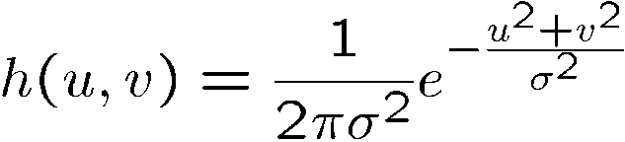
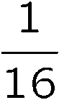
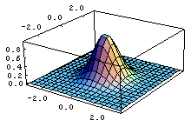
Gaussian filter
What if we want nearest neighboring pixels to have the most influence on the output?
This kernel is an approximation of a Gaussian function:
0 | 0 | 0 | 0 | 0 | 0 | 0 | 0 | 0 | 0
0 | 0 | 0 | 0 | 0 | 0 | 0 | 0 | 0 | 0
0 | 0 | 0 | 90 | 90 | 90 | 90 | 90 | 0 | 0
0 | 0 | 0 | 90 | 90 | 90 | 90 | 90 | 0 | 0
0 | 0 | 0 | 90 | 90 | 90 | 90 | 90 | 0 | 0
0 | 0 | 0 | 90 | 0 | 90 | 90 | 90 | 0 | 0
0 | 0 | 0 | 90 | 90 | 90 | 90 | 90 | 0 | 0
0 | 0 | 0 | 0 | 0 | 0 | 0 | 0 | 0 | 0
0 | 0 | 90 | 0 | 0 | 0 | 0 | 0 | 0 | 0
0 | 0 | 0 | 0 | 0 | 0 | 0 | 0 | 0 | 0
1 | 2 | 1
2 | 4 | 2
1 | 2 | 1
Removes high-frequency components from the image (it is a “low-pass filter”).
Source: S. Seitz

Slide 44
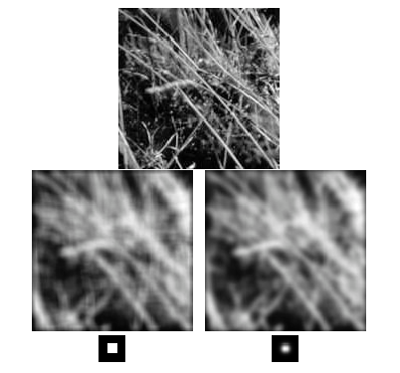
Gaussian vs. box filtering
Notes:
44

Slide 45
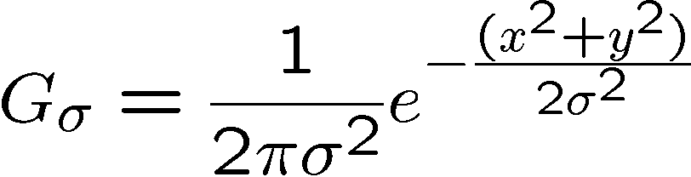
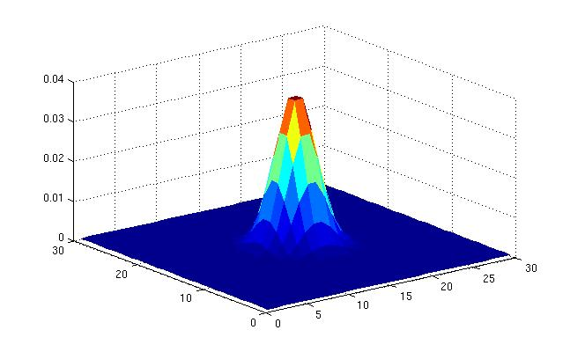
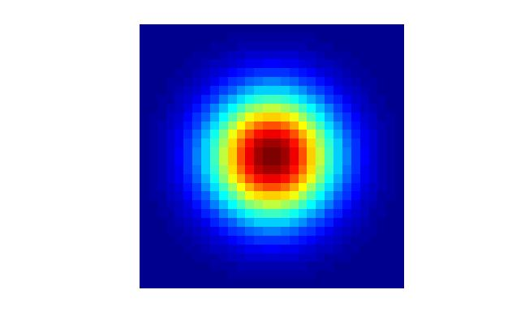
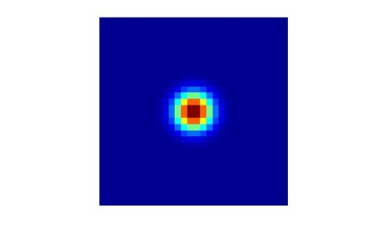
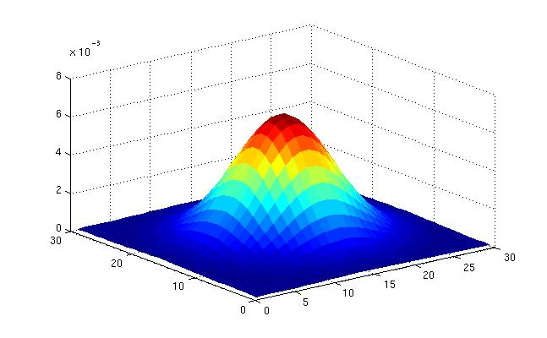
Gaussian Kernel
σ = 2 with 30 x 30 kernel
σ = 5 with 30 x 30 kernel
Standard deviation σ: determines extent of smoothing
Source: K. Grauman
Notes:
45

Slide 46
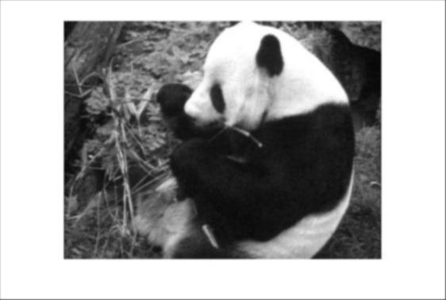
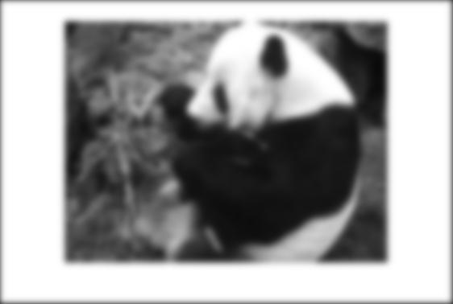
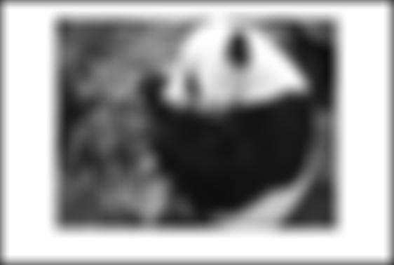



Smoothing with a Gaussian
Parameter σ is the “scale” / “width” / “spread” of the Gaussian kernel, and controls the amount of smoothing.
…
for sigma=1:3:10
h = fspecial('gaussian‘, fsize, sigma);
out = imfilter(im, h);
imshow(out);
pause;
end

Slide 47

Gaussian Filters

Slide 48
How big should the filter be?
Values at edges should be near zero ← important!
Rule of thumb for Gaussian: set filter half-width to about 3 σ
Notes:
48

Slide 49

Separable Filtering
Slide by S. Marschner

Slide 50
Sharpening revisited
Source: D. Lowe

Slide 51

Sharpening revisited
Notes:
51

Slide 52



Unsharp mask filter
image
blurred image
unit impulse (identity)
unit impulse
Gaussian
Laplacian of Gaussian
Notes:
52
f + a(f - f * g) = (1+a)f-af*g = f*((1+a)e-g)

Slide 53













Boundary issues
What about near the edge?
the filter window falls off the edge of the image
need to extrapolate
methods:
clip filter (black)
wrap around
copy edge
reflect across edge
Source: S. Marschner
Notes:
53

Slide 54
Boundary issues
Source: S. Marschner
What about near the edge?
the filter window falls off the edge of the image
need to extrapolate
methods (MATLAB):
clip filter (black): imfilter(f, g, 0)
wrap around: imfilter(f, g, ‘circular’)
copy edge: imfilter(f, g, ‘replicate’)
reflect across edge: imfilter(f, g, ‘symmetric’)
Notes:
54

Slide 55
Common Types of Noise
Salt and pepper noise: contains random occurrences of black and white pixels
Impulse noise: contains random occurrences of white pixels
Gaussian noise: variations in intensity drawn from a Gaussian normal distribution
Source: S. Seitz
Notes:
55
Salt and pepper and impulse noise can be due to transmission errors (e.g., from deep space probe), dead CCD pixels, specks on lens

Slide 56

Gaussian noise
>> noise = randn(size(im)).*sigma;
>> output = im + noise;
Fig: M. Hebert

Slide 57


Reducing Gaussian noise
Smoothing with larger standard deviations suppresses noise, but also blurs the image
Notes:
57

Slide 58

Reducing salt-and-pepper noise
3x3
5x5
7x7
What’s wrong with the results?
Notes:
58

Slide 59

Alternative idea: Median filtering
A median filter operates over a window by selecting the median intensity in the window
Is median filtering linear?
Source: K. Grauman
Notes:
59
Linearity of median filter: try filter([0 0 0; 0 1 0; 0 0 0] + [1 1 1; 1 1 2; 2 2 2])

Slide 60

Median filter
What advantage does median filtering have over Gaussian filtering?
Robustness to outliers
Edge preserving
Source: K. Grauman
Notes:
60

Slide 61

Median filter
Salt and pepper noise
Median filtered
Plots of a row of the image
Source: M. Hebert

Slide 62

Gaussian vs. median filtering
3x3
5x5
7x7
Gaussian
Median
Notes:
62

Slide 63
Readings
Szeliski Book
Chapter 2 and 3

